Slide 1
Risk Management

Slide 2
REACTIVE VERSUS PROACTIVE RISK STRATEGIES
Reactive risk strategies monitors the project for likely risks. Resources are set aside to deal with them, should they become actual problems
Yet, the majority of software teams rely solely on reactive risk strategies.
More commonly, the software team does nothing about risks until something goes wrong. Then, the team flies into action in an attempt to correct the problem rapidly.
This is often called a fire-fighting mode. When this fails, “crisis management” takes over and the project is in real jeopardy.

Slide 3
A considerably more intelligent strategy for risk management is to be proactive.
A proactive strategy begins long before technical work is initiated. Potential risks are identified, their probability and impact are assessed, and they are ranked by importance. Then, the software team establishes a plan for managing risk.
The primary objective is to avoid risk, but because not all risks can be avoided, the team works to develop a contingency plan that will enable it to respond in a controlled and effective manner.

Slide 4
5.2 SOFTWARE RISKS
Risk always involves two characteristics:
Uncertainty - the risk may or may not happen; that is, there are no 100 percent probable risks and
Loss - if the risk becomes a reality, unwanted consequences or losses will occur.
When risks are analyzed, it is important to quantify the level of uncertainty and the degree of loss associated with each risk.

Slide 5
To accomplish this, different categories of risks are considered.
Project risks threaten the project plan. That is, if project risks become real, it is likely that the project schedule will slip and that costs will increase.
Project risks identify potential budgetary, schedule, personnel (staffing and organization) resource, stakeholder, and requirements problems and their impact on a software project.
Project complexity, size, and the degree of structural uncertainty were also defined as project (and estimation) risk factors

Slide 6
Technical risks threaten the quality and timeliness of the software to be produced.
If a technical risk becomes a reality, implementation may become difficult or impossible.
Technical risks identify potential design, implementation, interface, verification, and maintenance problems.
In addition, specification ambiguity, technical uncertainty, technical obsolescence, and “leading-edge” technology are also risk factors.
Technical risks occur because the problem is harder to solve than you thought it would be.

Slide 7
Business risks threaten the viability of the software to be built and often risk the project or the product.
Candidates for the top five business risks are
Building an excellent product or system that no one really wants (market risk),
Building a product that no longer fits into the overall business strategy for the company (strategic risk),
Building a product that the sales force doesn’t understand how to sell (sales risk),
Losing the support of senior management due to a change in focus or a change in people. (management risk)
Losing budgetary or personnel commitment (budget risks).

Slide 8
Known risks are those that can be uncovered after careful evaluation of the project plan, the business and technical environment in which the project is being developed, and other reliable information sources (e.g., unrealistic delivery date, lack of documented requirements or software scope, poor development environment).
Predictable risks are extrapolated from past project experience (e.g., staff turnover, poor communication with the customer, dilution of staff effort as ongoing maintenance requests are serviced).
Unpredictable risks are the joker in the deck. They can and do occur, but they are extremely difficult to identify in advance.

Slide 9
5.3 RISK IDENTIFICATION
Risk identification is a systematic attempt to specify threats to the project plan (estimates, schedule, resource loading, etc.).
By identifying known and predictable risks, the project manager takes a first step toward avoiding them when possible and controlling them when necessary.
There are two distinct types of risks for each of the categories that have been presented .
Generic risks are a potential threat to every software project.
Product-specific risks can be identified only by those with a clear understanding of the technology, the people, and the environment that is specific to the software that is to be built.
To identify product-specific risks, the project plan and the software statement of scope are examined.

Slide 10
One method for identifying risks is to create a risk item checklist. The checklist can be used for risk identification and focuses on some subset of known and predictable risks in the following generic subcategories:
• Product size —Risks associated with the overall size of the software to be built or modified.
• Business impact —Risks associated with constraints imposed by management or the marketplace.
• Stakeholder characteristics —Risks associated with the sophistication of the stakeholders and the developer’s ability to communicate with stakeholders in a timely manner.

Slide 11
• Process definition —Risks associated with the degree to which the software process has been defined and is followed by the development organization.
• Development environment -Risks associated with the availability and quality of the tools to be used to build the product.
• Technology to be built —Risks associated with the complexity of the system to be built and the “newness” of the technology that is packaged by the system.
• Staff size and experience —Risks associated with the overall technical and project experience of the software engineers who will do the work.

Slide 12
5.3.1 Assessing Overall Project Risk
The following questions have been derived from risk data obtained by surveying experienced software project managers in different parts of the world.
The questions are ordered by their relative importance to the success of a project.
Have top software and customer managers formally committed to support the project?
Are end users enthusiastically committed to the project and the system/product to be built?
Are requirements fully understood by the software engineering team and its customers?
Have customers been involved fully in the definition of requirements?
Do end users have realistic expectations?
Is the project scope stable?

Slide 13
Does the software engineering team have the right mix of skills?
Are project requirements stable?
Does the project team have experience with the technology to be implemented?
Is the number of people on the project team adequate to do the job?
Do all customer/user constituencies agree on the importance of the project and on the requirements for the system/product to be built?
If any one of these questions is answered negatively, mitigation, monitoring, and management steps should be instituted without fail.
The degree to which the project is at risk is directly proportional to the number of negative responses to these questions.

Slide 14
5.3.2 Risk Components and Drivers
The approach requires that the project manager identify the risk drivers that affect software risk components—performance, cost, support, and schedule.
The risk components are defined in the following manner:
• Performance risk -The degree of uncertainty that the product will meet its requirements and be fit for its intended use.
• Cost risk —The degree of uncertainty that the project budget will be maintained.
• Support risk —The degree of uncertainty that the resultant software will be easy to correct, adapt, and enhance.
• Schedule risk —The degree of uncertainty that the project schedule will be maintained and that the product will be delivered on time.

Slide 15
5.4 RISK PROJECTION
Risk projection , also called risk estimation, attempts to rate each risk in two ways -
the likelihood or probability that the risk is real and will occur and
the consequences of the problems associated with the risk, should it occur.
You work along with other managers and technical staff to perform four risk projection steps:
Establish a scale that reflects the perceived likelihood of a risk.
Delineate the consequences of the risk.
Estimate the impact of the risk on the project and the product.
Assess the overall accuracy of the risk projection so that there will be no misunderstandings.

Slide 16
The intent of these steps is to consider risks in a manner that leads to prioritization. No software team has the resources to address every possible risk with the same degree of rigor. By prioritizing risks, you can allocate resources where they will have the most impact.

Slide 17
A risk management strategy can be defined as a software project plan or the risk management steps.
It can be organized into a separate Risk Mitigation, Monitoring and Management Plan. The RMMM plan documents all work performed as part of risk analysis and is used by the project manager as part of the overall project plan.
Teams do not develop a formal RMMM document. Rather, each risk is documented individually using a risk information sheet .

Slide 18
Once RMMM has been documented and the project has begun, risk mitigation and monitoring steps commence.
Risk mitigation is a problem avoidance activity. Risk monitoring is a project tracking activity with three primary objectives:
(1) To assess whether predicted risks occur.
(2) To ensure that risk aversion steps defined for the risk are being properly applied; and
(3) To collect information that can be used for future risk analysis.

Slide 19
Effective strategy must consider three issues:
risk avoidance
risk monitoring
risk management and contingency planning.
Proactive approach to risk – avoidance strategy.
Develop risk mitigation plan.
Develop a strategy to mitigate this risk for reducing turnover.
Meet with current staff to determine causes for turnover.
Mitigate those causes that are under our control before the project starts.
Organize project teams so that information about each development activity is widely dispersed.

Slide 20
Define documentation standards and establish mechanisms to be sure that documents are developed in a timely manner.
Project manager monitors for likelihood of risk.
Project manager should monitor the effectiveness of risk mitigation steps.
Risk management and contingency planning assumes that mitigation efforts have failed and that the risk has become a reality.
RMMM steps incur additional project cost.

Slide 21
THE RMMM PLAN
Risk Mitigation, Monitoring and Management Plan (RMMM) – documents all work performed as part of risk analysis and is used by the project manager as part of the overall project plan. RISK is maintained using a database system, so that creation and information entry, priority ordering, searches, and other analysis may be accomplished easily.
Risk monitoring is a project tracking activity
Three primary objectives:
Assess whether predicted risks do, or occur
Ensure that risk aversion steps defined for the risk are being properly applied
Collect information that can be used for future risk analysis.

Slide 22
RMMM (RISK MITIGATION,MONITORING AND MANAGEMENT)
PLAN Analyze the risk which is related to the project and prepare RMMM plan.
Objective Risk Mitigation is a problem avoidance activity, Risk Monitoring is a project tracking activity, Risk Management includes contingency plans that risk will occur.
The goal of the risk mitigation, monitoring and management plan is to identify as many potential risks as possible. Risk is a potential problem it might happen, it might not. To determine the potential risks checklists are used.
These checklists help to identify potential risks in a generic sense.
The project will then be analyzed to determine any project-specific risks.

Slide 23
When all risks have been identified, they will then be evaluated to determine their probability of occurrence.
Plans will then be made to avoid each risk, to track each risk to determine if it is more or less likely to occur, and to plan for those risks should they occur.
The primary objective of risk mitigation can be achieved by developing a plan.
The objectives of monitoring are to assess whether predicted risks do/in-fact occur, to ensure that risk aversion steps defined for the risk are being properly applied, to collect information that can be used for future risk analysis.

Slide 24
THE RISK MANAGEMENT: The risk management process can be broken down into two interrelated phases, risk assessment and risk control. These phases are further broken down. Risk assessment involves risk identification, risk analysis, and risk prioritization. Risk control involves risk planning, risk mitigation, and risk monitoring. It is essential that risk management be done iteratively, throughout the project, as a part of the team’s project management routine.

Slide 25
Procedure RISK MITIGATION: Related to risk planning, through risk mitigation, the team develops strategies to reduce the possibility or the loss impact of a risk. Risk mitigation produces a situation in which the risk items are eliminated or otherwise resolved. Risk avoidance: When a lose-lose strategy is likely, the team can opt to eliminate the risk is an example of a risk avoidance strategy is the team opting not to develop a product or a particularly risky feature.

Slide 26
RISK MONITORING: After risks are identified, analyzed, and prioritized, and actions are established, it is essential that the team regularly monitor the progress of the product and the resolution of the risk items, taking corrective action when necessary. This monitoring can be done as part of the team project management activities or via explicit risk management activities. Often teams regularly monitor their “Top 10 risks.”

Slide 27
Software Configuration Management
Software Configuration Management is a set of activities carried to identify, organize and control changes throughout the lifecycle of software.

Slide 28
SCM Repository
Role of Project Repository
  Software repository is a collection of information accessed by software engineers.
  It is important to maintain data integrity, sharing and integration
  Features
      Versioning
      Dependency Tracking and Change Management
      Requirements Tracing
      Configuration Management
      Audit

Slide 29
The SCM Process
The primary objectives of SCM are:
  Configuration Identification
  Change Control
  Version Control
  Configuration Authentication

Slide 30
Identification of Objects in Software Configuration
The configuration items must be separately named and identified as object.
There are two categories of objects – basic objects and aggregate objects.
Basic object is a unit of information created during requirement analysis, design, coding or testing. For e.g. basic object can be a part of source code.
Aggregate object is a collection of basic objects e.g. SRS or data model

Slide 31
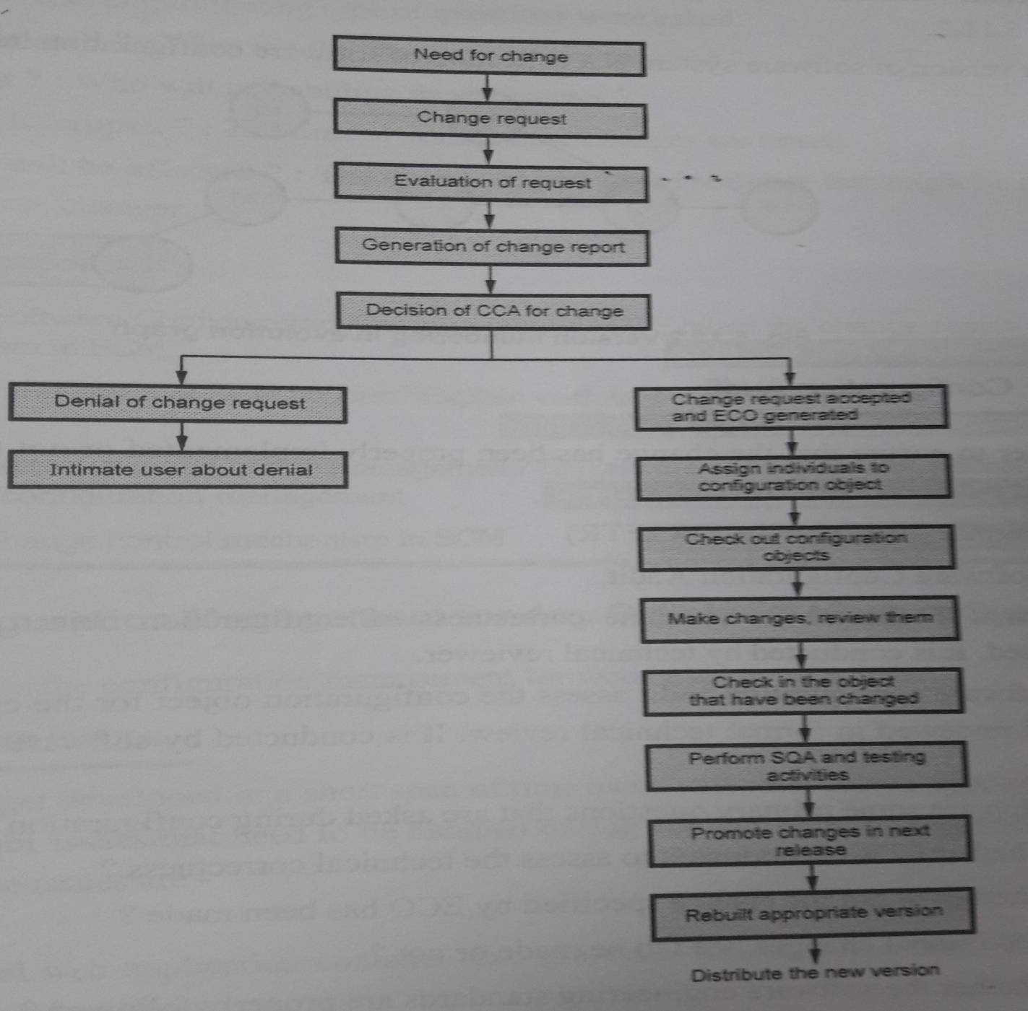
Change Control

Slide 32
Version Control
Version is an instance of a system which is functionally distinct in some way from other system instances.
Certain attributes are associated with each software version. The attributes can be ‘date’, ‘creator’, ’customer’, ’status’.

Slide 33
Configuration Audit
In order to ensure that the change has been properly implemented or not, two activities are carried out
Formal Technical Review(FTR)
Software Configuration Audit(SCA)
In FTR, the correctness of configuration is identified and corrected if required.
The SCA assess the configuration for the characteristics that are nit received in FTR.

Slide 34
Status Reporting
The status reporting focuses on communication of changes to all people in an organization that involve with changes.
During status reporting following questions are asked:
  What happened?
  Who did it?
  When did it happen?
  What else will be affected?

Slide 35
Configuration Management for Any Suitable Software Sysem
We will discuss the configuration management for web based applications.
Dominant Issues
    Content
    People
    Scalability
    Politics
Content Management
    Collection Subsystem
    Management Subsystem
    Publishing Subsystem

Slide 36
Change Management
Version Control
Auditing and Reporting

